Slide 1

AIDI1012 - 23W AI ROBOTICS AND AUTOMATION
ASSIGNMENT 4
A2 GROUP MEMBERS
Shivani Bajaj(200527764)
Cheuk Ying Iu(200514612)
Fangji Chen(200520598)
Ayesha Siddiqa(200502171)
Taekeon Kim(200452564)
Shivansh Setia(200511522)
Harshal Shashikant Bhasgauri(200499159)
Hamza Kadodia(200535827)
Sahil Singal( 200506536)
Himanshu (200535823)

Slide 2

Explain about steps to Launch the container and issues to run the ROS or GAZEBO container

Slide 3
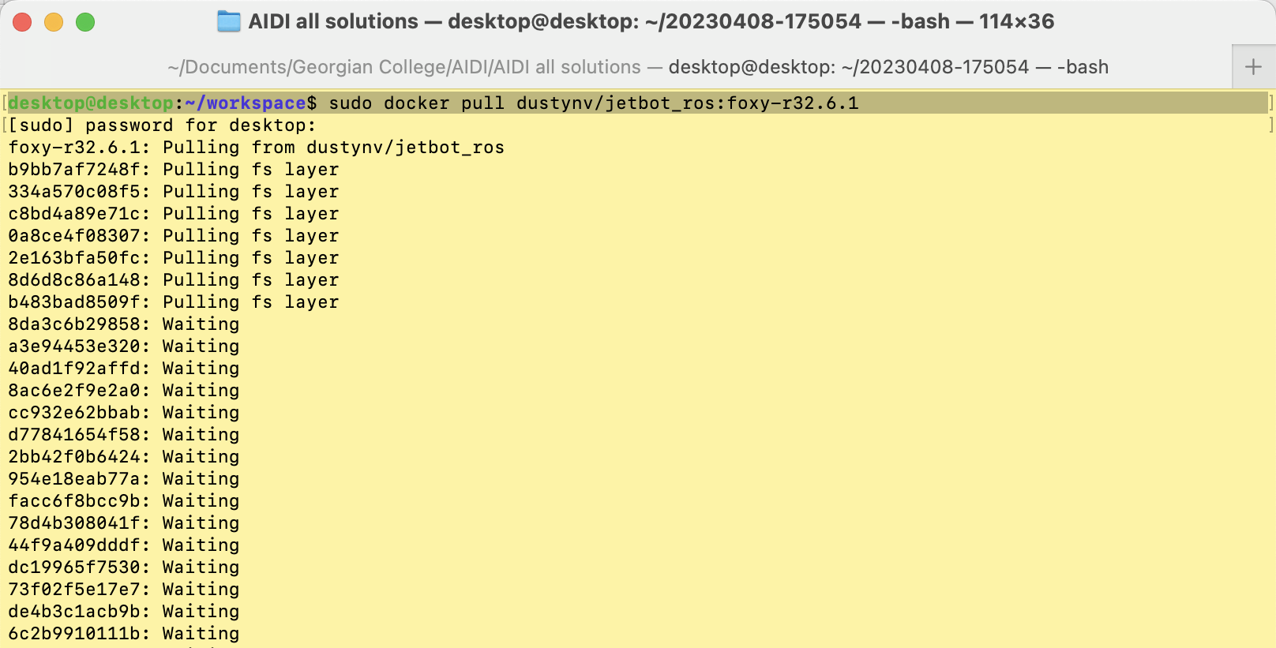
Download the container

Slide 4
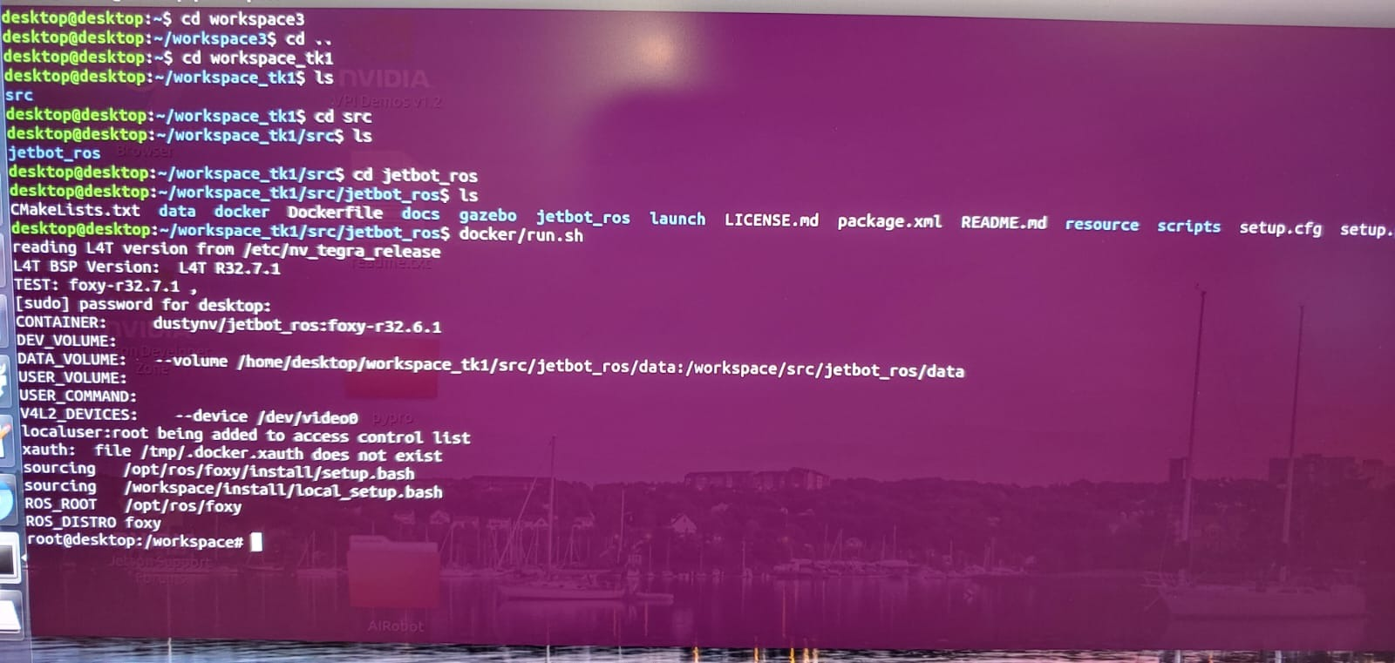
Launch the container
This is the data collection command

Slide 5
Explain the CNN algorithm

Slide 7
Data collection and training

Slide 8
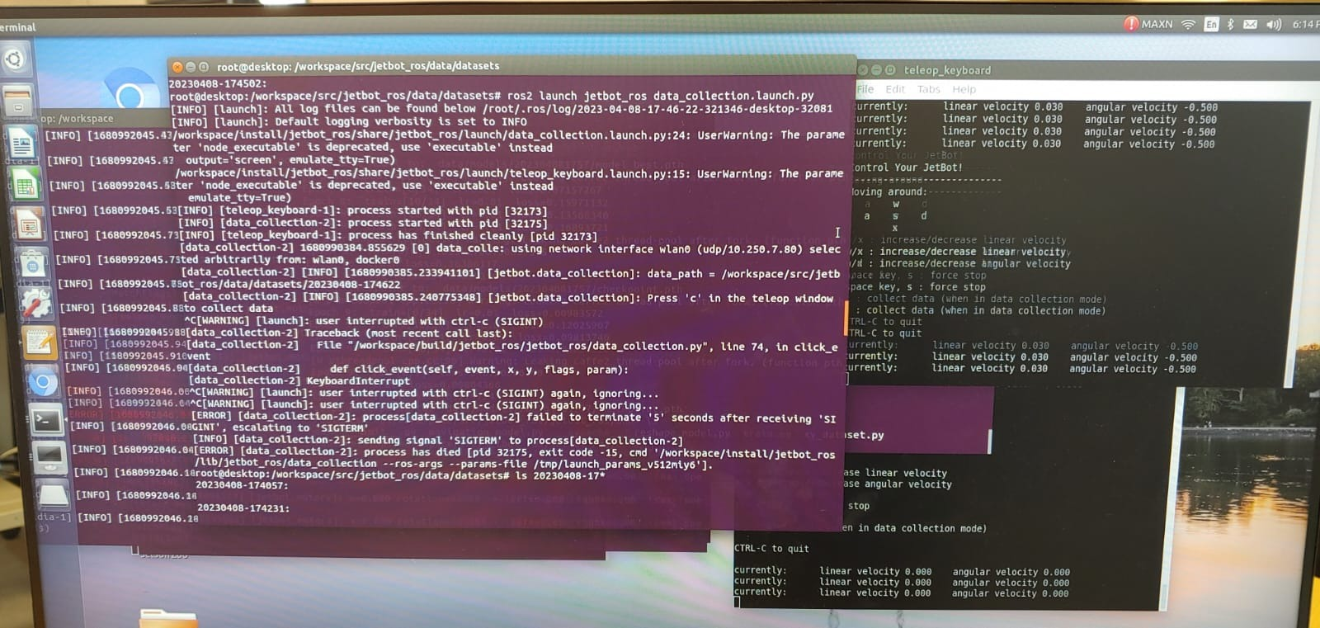
Data collecting
This is the data collection command
This is the window to catch our keyboard actions

Slide 9
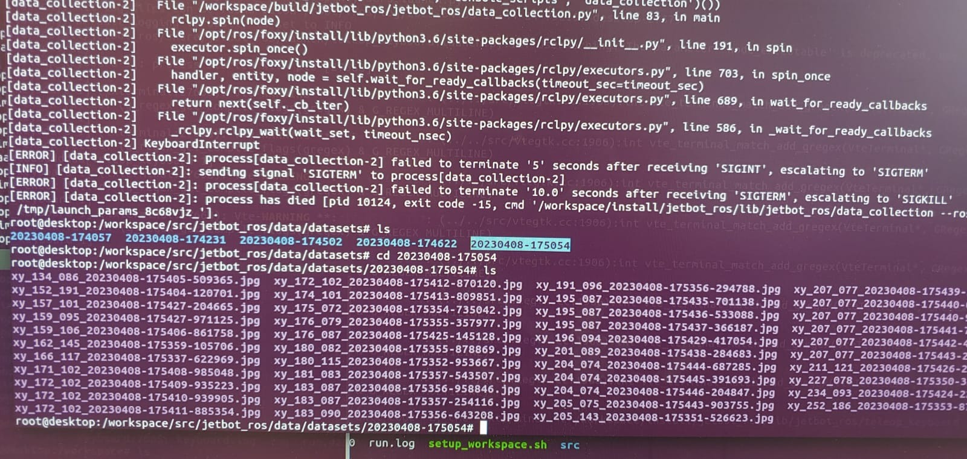
Collected training data
This is the collected training images

Slide 10
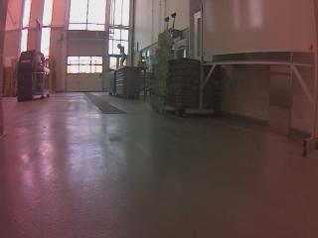
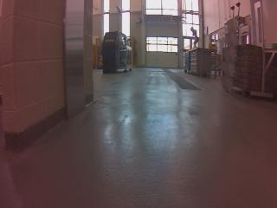
Training data examples

Slide 11
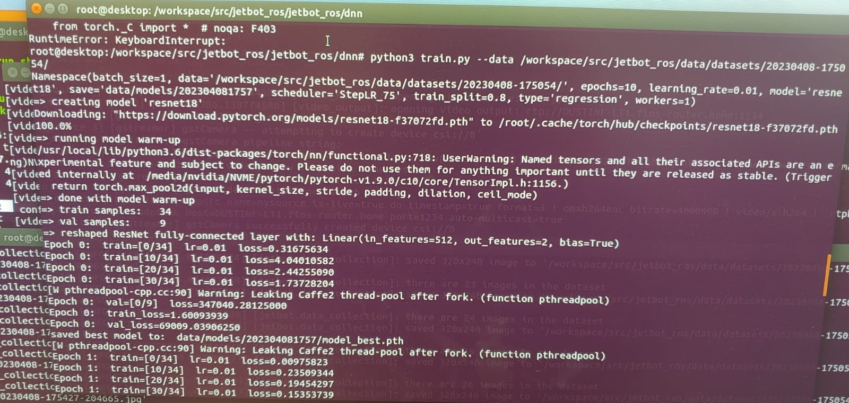
training
This is the training command

Slide 12
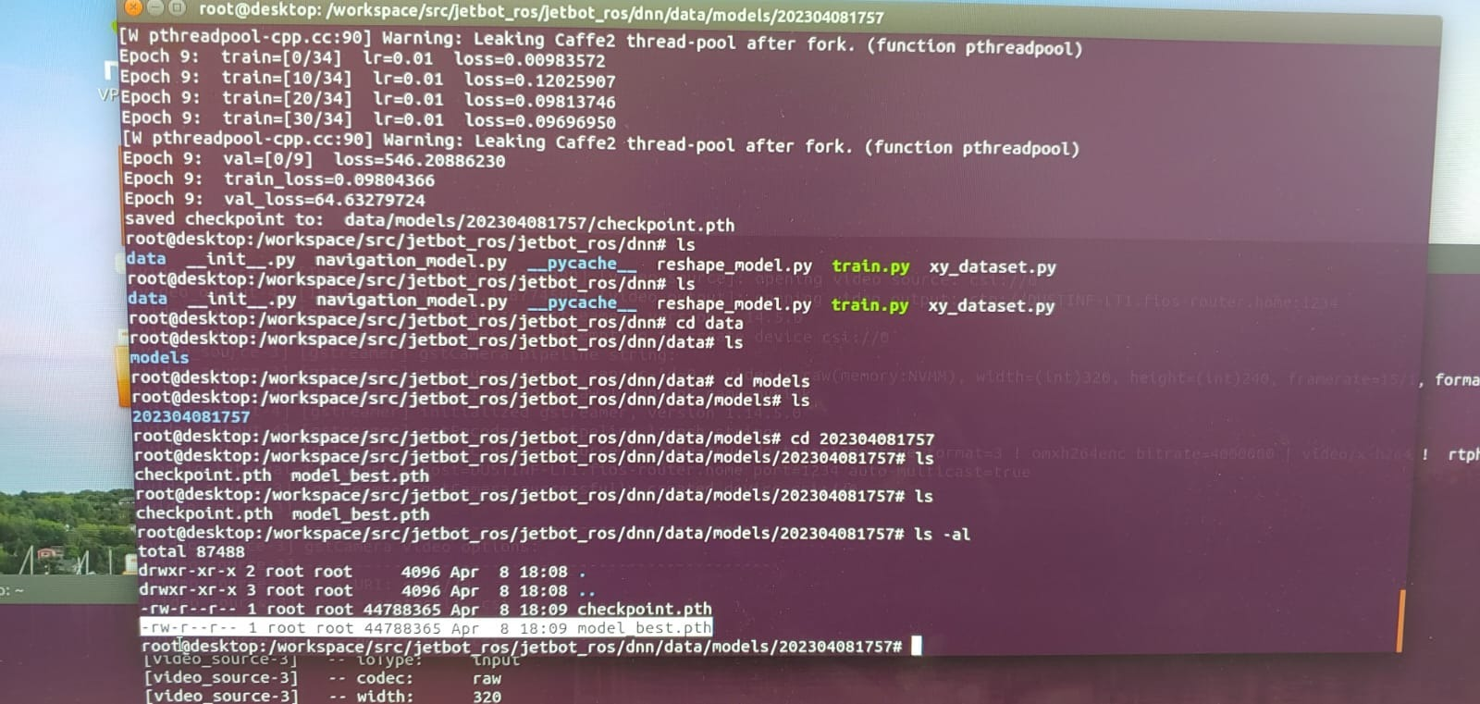
Training results
This are the training results:
Checkpoint.pth and model_best.pth

Slide 13
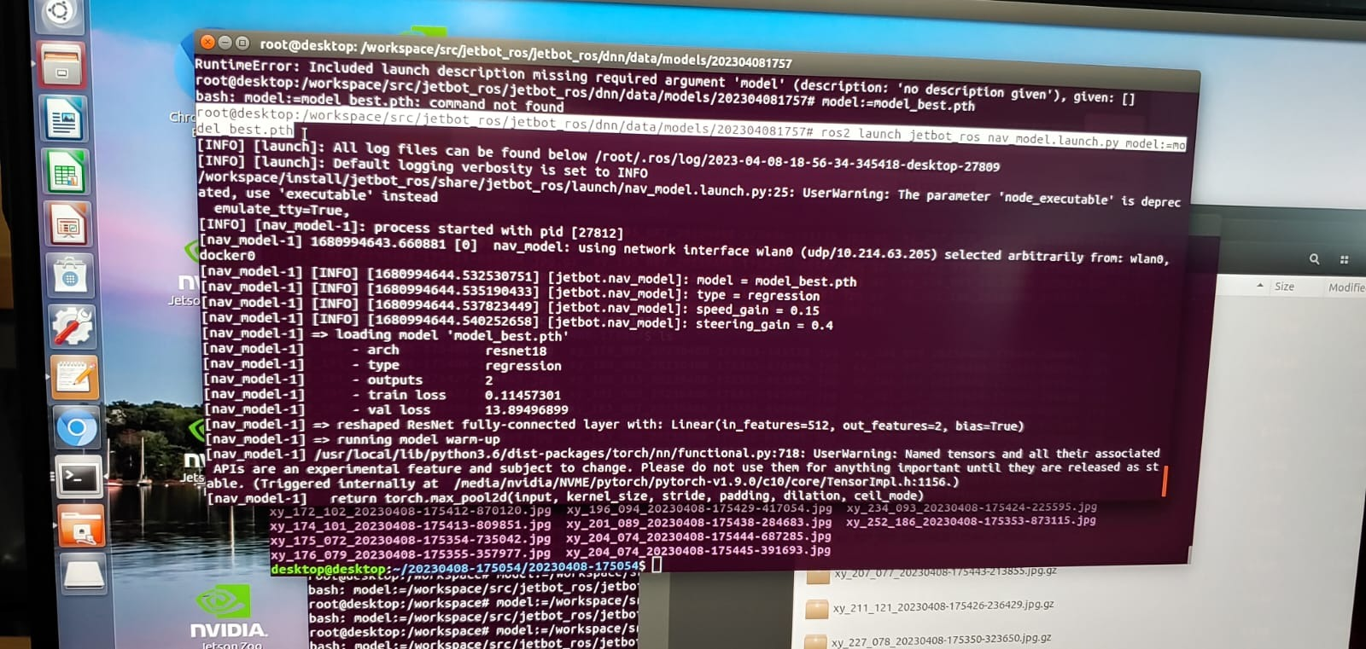
Running model with the model file
This is the model running command:
The weights file “model_best.pth” is loaded

